Slide 1
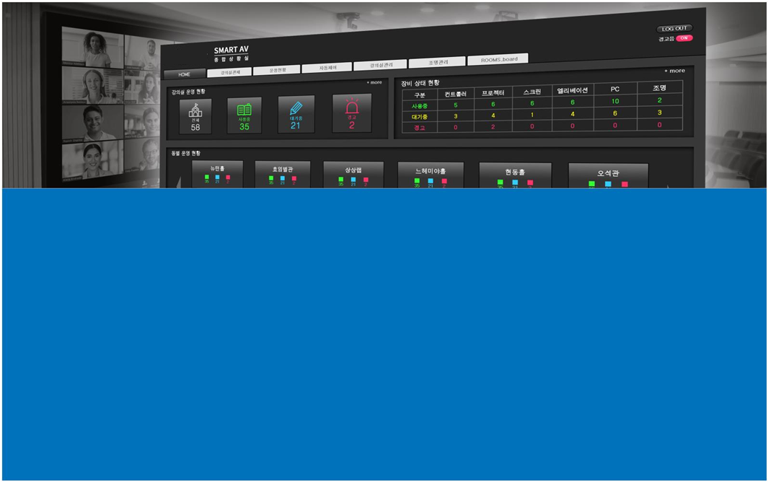
Ⅲ
SMART MANAGER

Slide 2
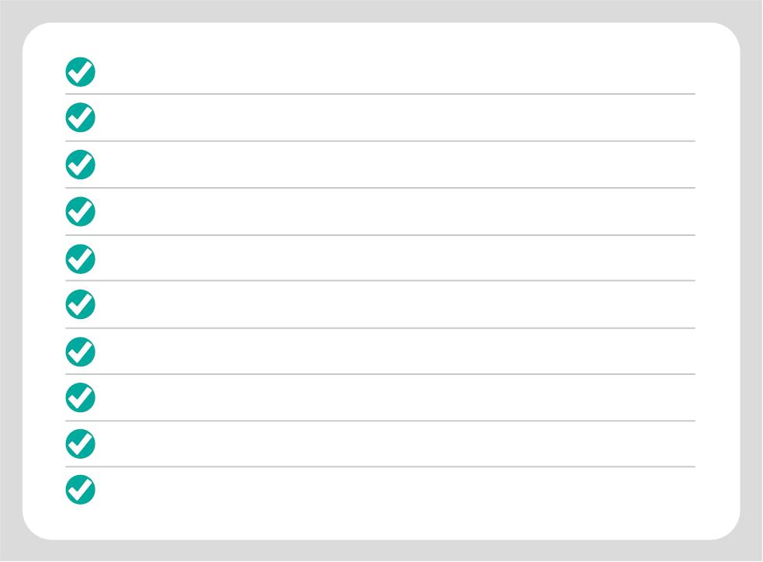
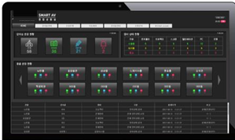
THE MAIN FUNCTIONS OF SMART MANAGER
To monitor the current states of whole classrooms
To monitor and check the whole devices by each classroom.
To monitor and control the AV devices by each building.
possible to control OFF function of day reservation
by class building or classrooms (Batch OFF of AV equipment).
SMART MANAGER SOFTWARE
Possible to control Power of PC in Podium.
Real-time monitoring of projector status and lamp usage time.
To check and control the lighting condition in classroom. (Optional)
Monitoring and control the devices in classrooms
with administrator’s PC and all mobile phone.

Slide 3
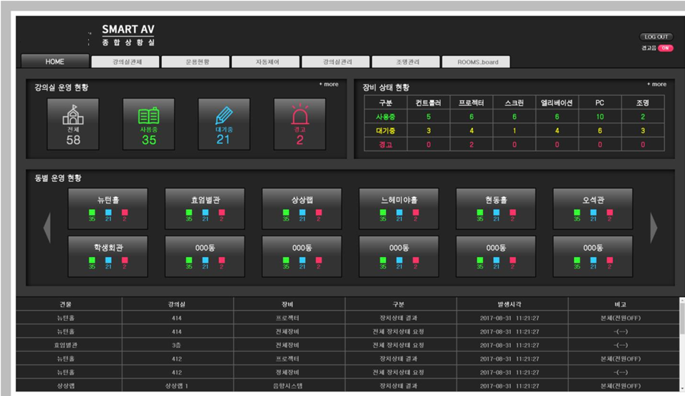
Integrated management system
for the entire classroom management screen

Slide 4
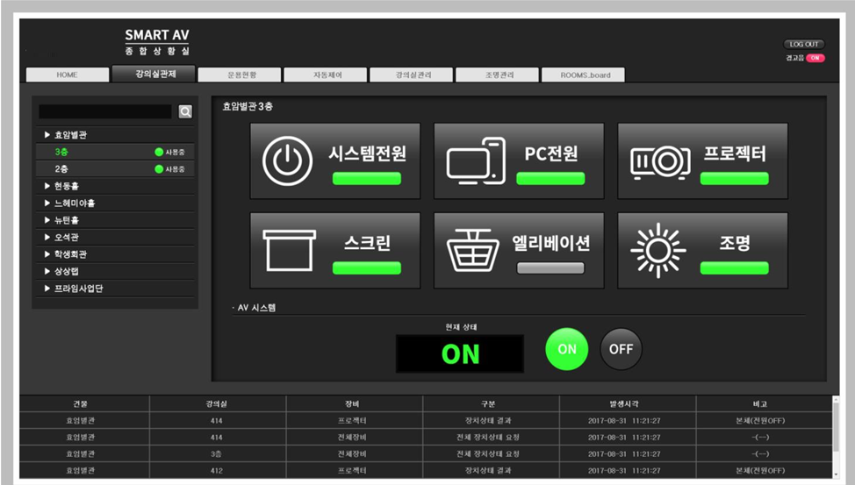
Classroom management screen

Slide 5
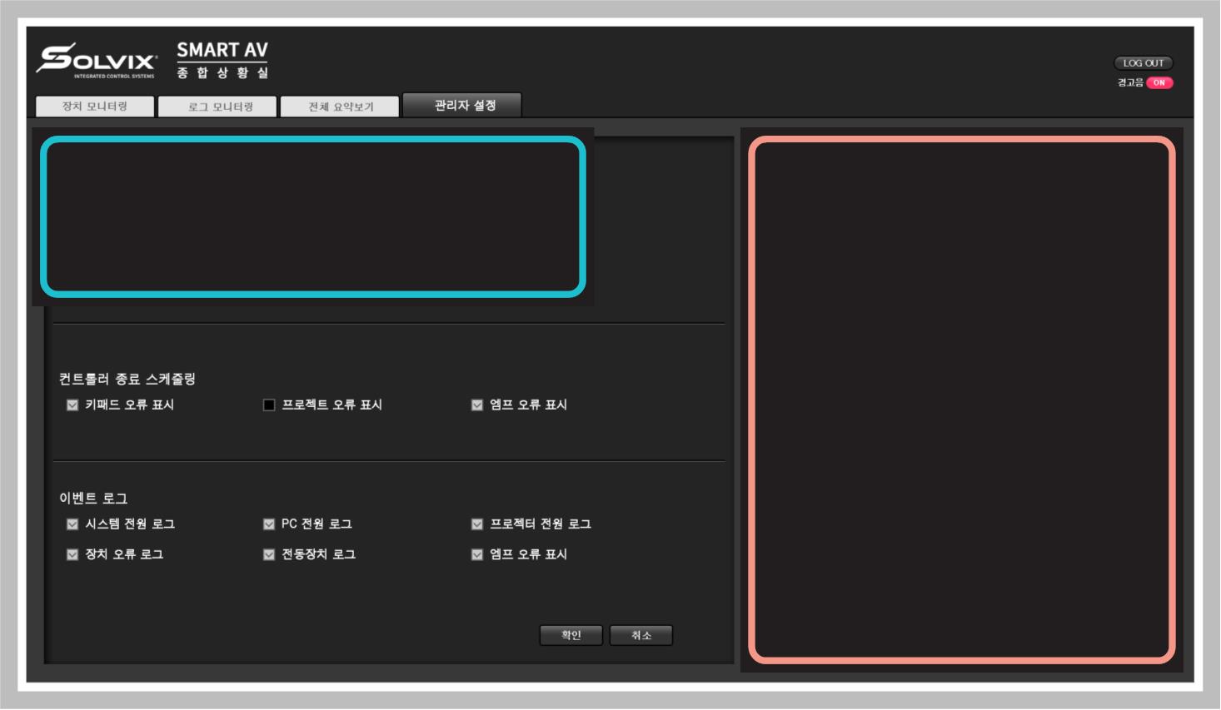
Administrator setting screen
< 그룹 관리자 및 그룹 설정 기능 >
< 요일별 예약 OFF설정 기능(그룹&전체) >
※ 본 화면은 이해를 돕기위해 실제 구성에 맞춘 예시화면입니다.

Slide 6
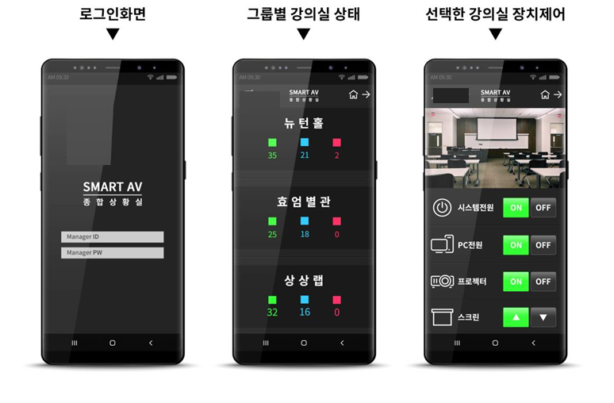
Management screen on mobile phone
Can monitor the condition of devices in all classrooms and control all connected devices in whole classrooms.
Devices control in selected classroom
Log in
Classroom status by group

Slide 7
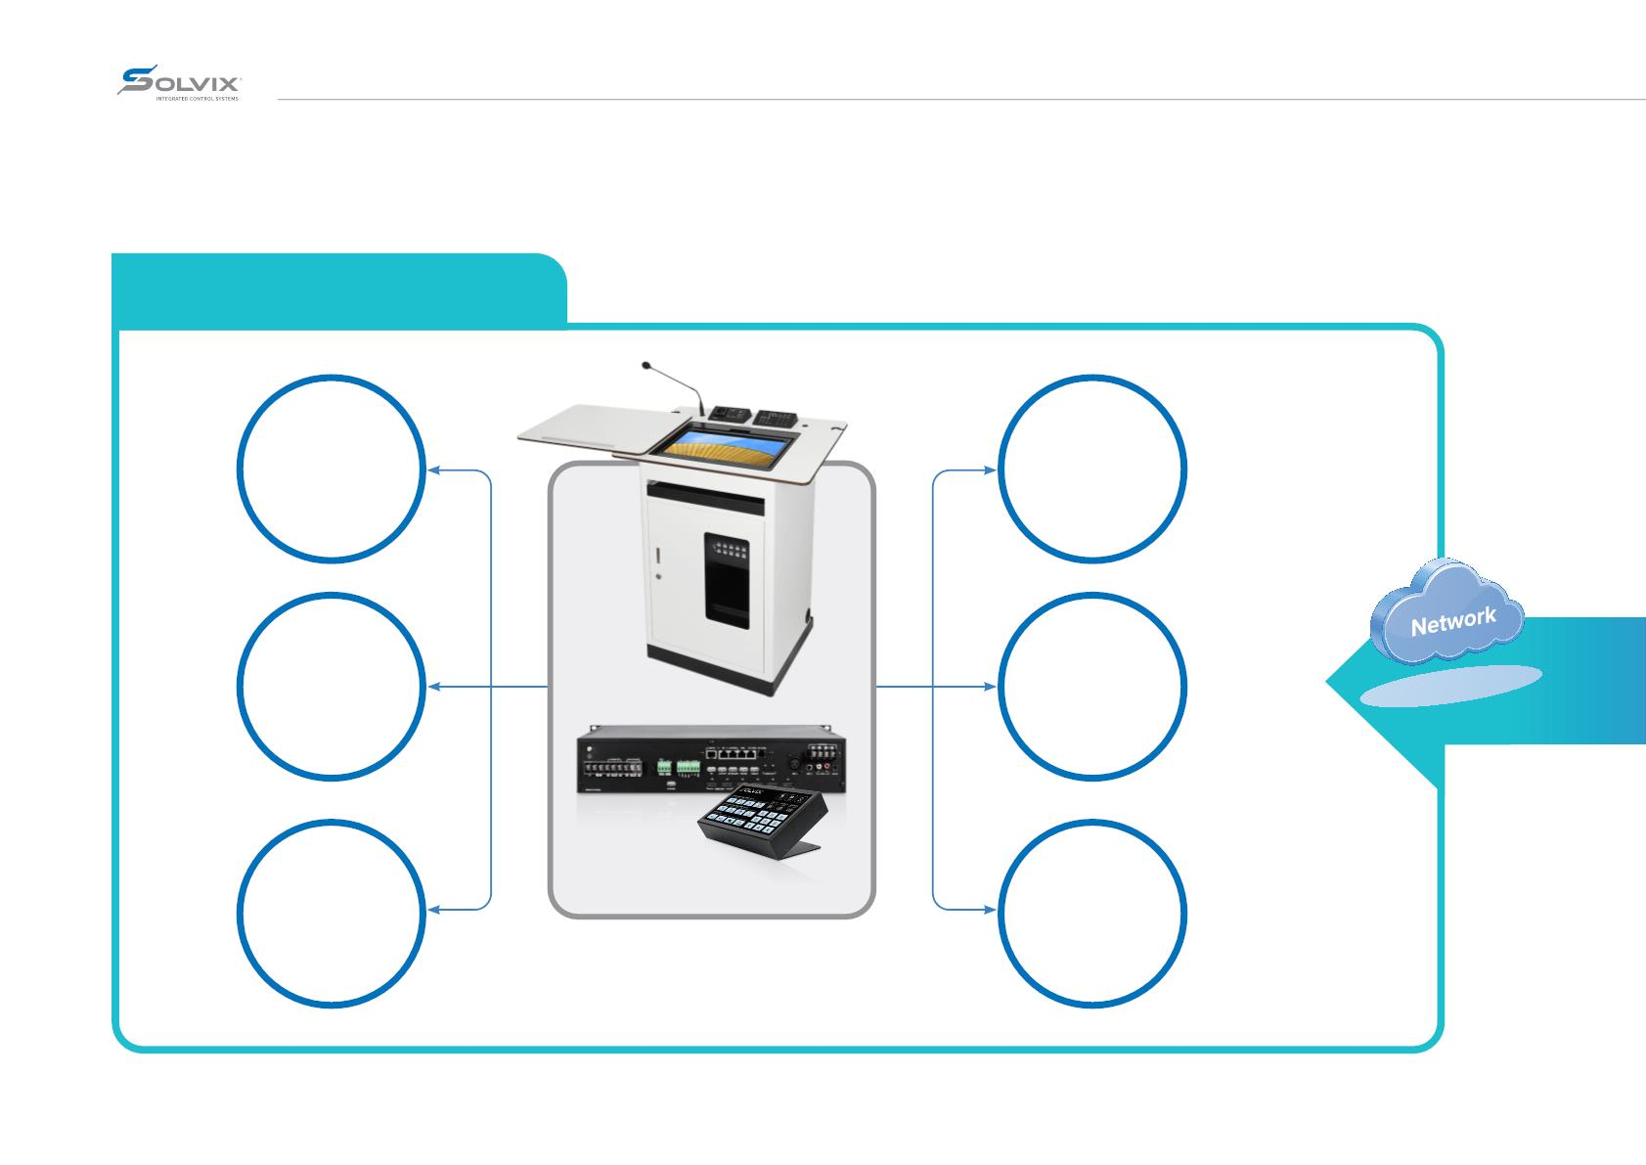
Integrated management scope
Smart classroom based on loT
Projector control
PBL Classroom Devices control
Electric devices control
Lecture recording equipment control
PC Power control
Classroom lighting control

Slide 8
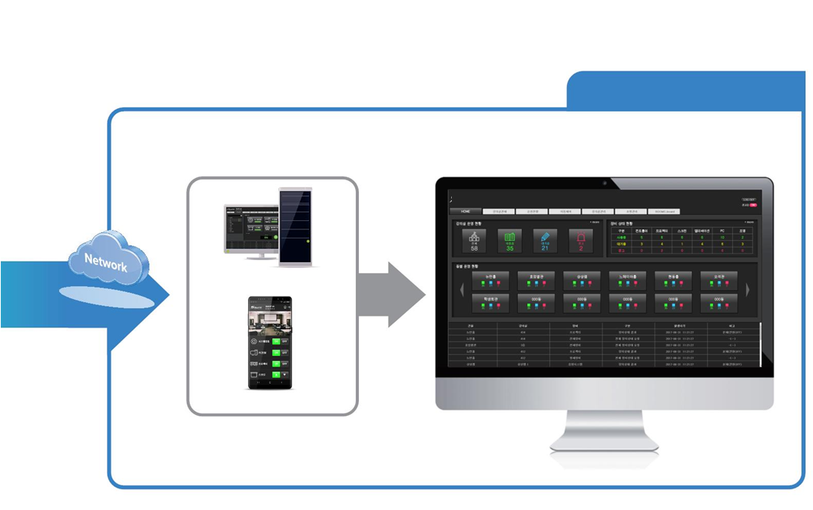
Management department
Administrator PC/ Sever
Mobile phone
To monitor and control the AV devices by each building.

Slide 9
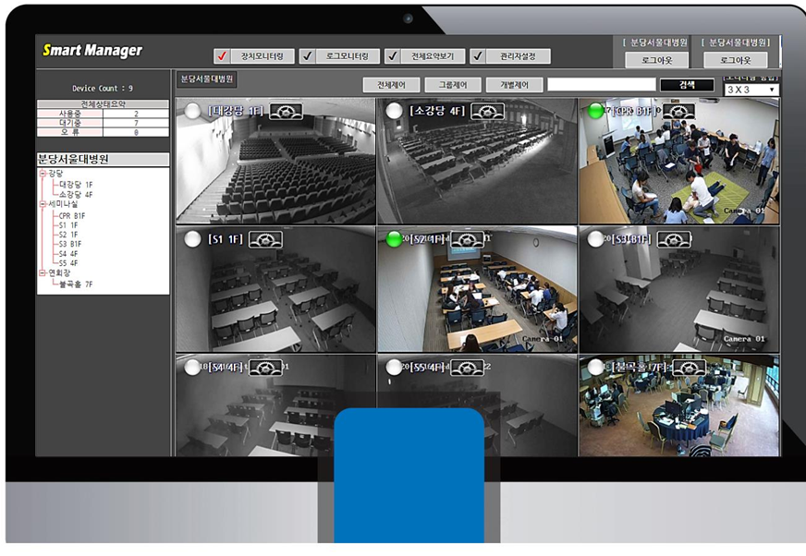
Installation – Sample 1
IP
CAMERA
Type

Slide 10
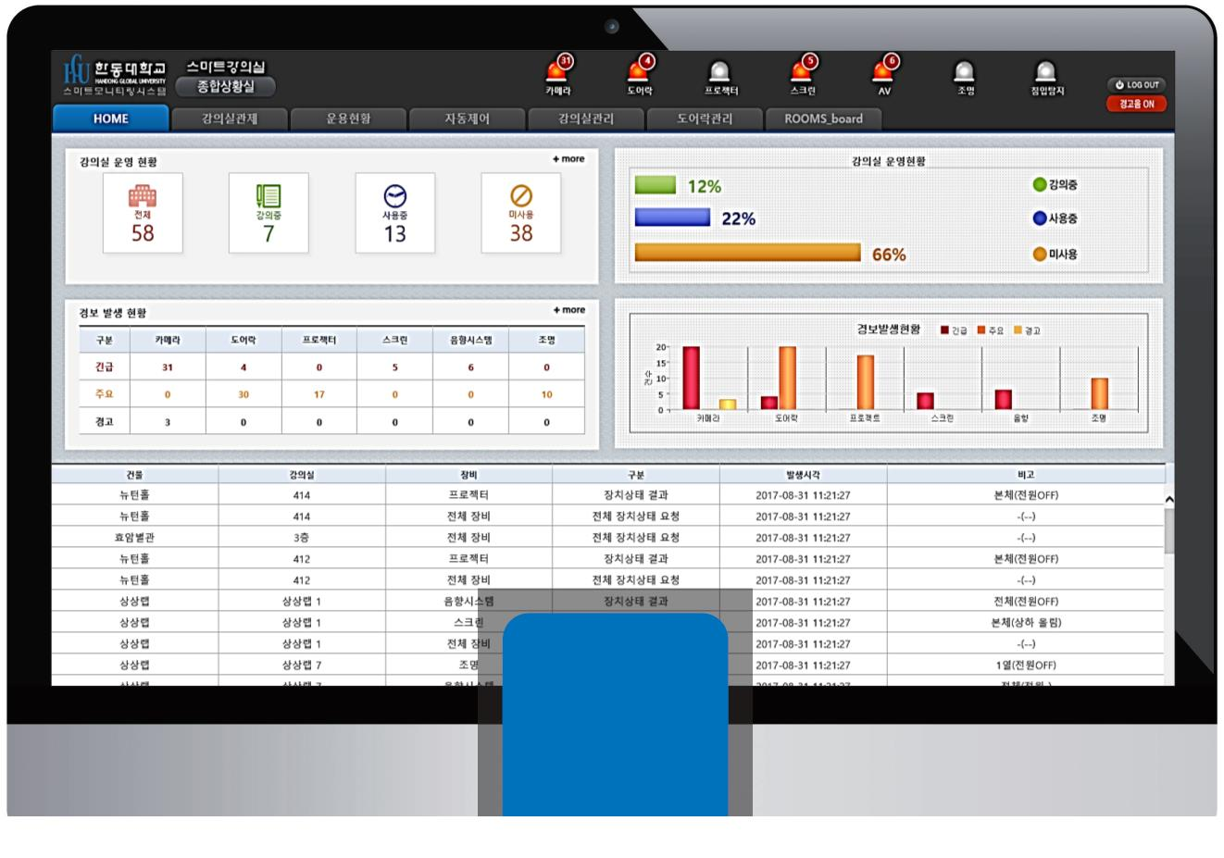
Installation – Sample 2
Type

Slide 11
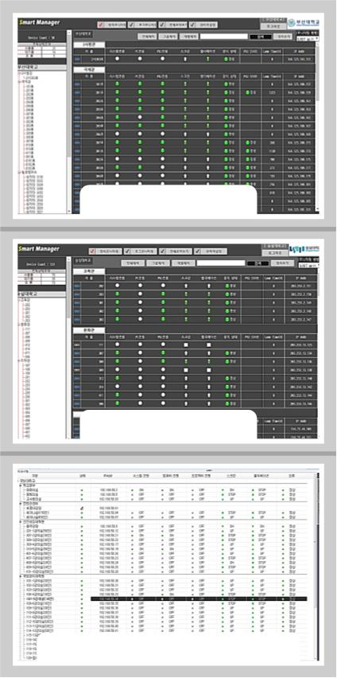
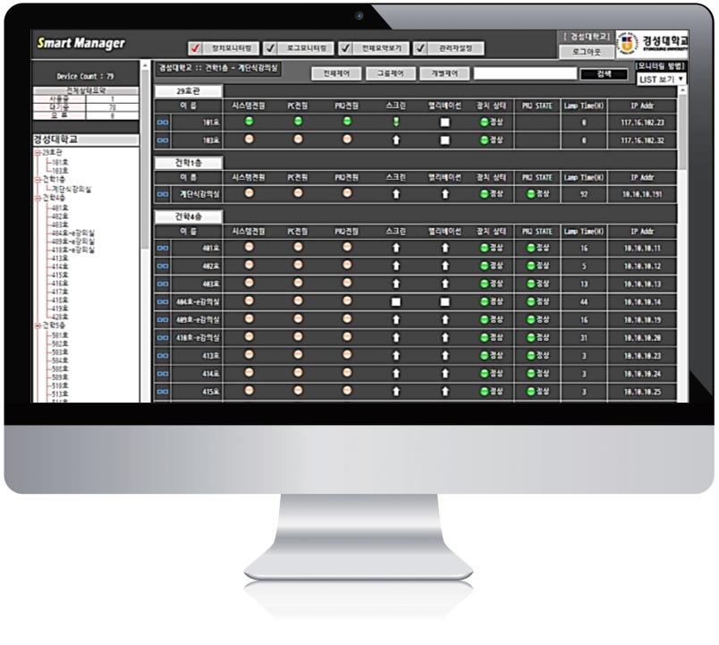
Installation – Sample 3
< 부산대학교 215실 >
< 숭실대학교 250실 >
< 국방대학교 논산이전 신축 71실 구축 >

